Slide 1
It’s Time for the Atmospheric Science Community to ACT Together
Collaborators/Contributors/All Around Amazing People
Ken Kehoe, Zach Sherman, Jason Hemedinger, Alyssa Sockol, Bobby Jackson, Corey Godine, Jenni Kyrouac, Michael Giansiricusa, Austin King, Scott Collis, Nicki Hickmon, Max Levin
Effort is supported by the Department of Energy, Atmospheric Radiation Measurement User Facility
Adam Theisen
Atmospheric Radiation Measurement User Facility
Department of Energy
Argonne National Laboratory

Slide 2

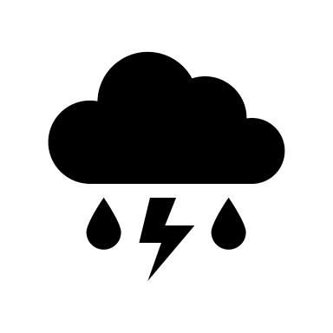








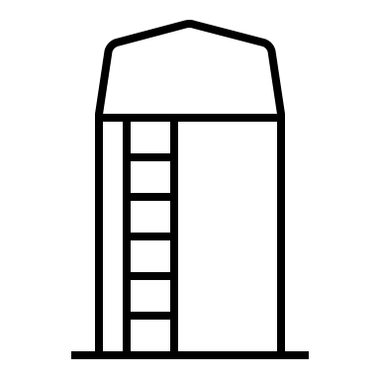


Framing the Problem
Notes:
Before we dive into the python tool itself, I wanted to talk about why we saw a need for another python tool. So, let’s start by framing the problem. Everyone’s career paths and experiences are different, but I am going to try and articulate the problem based on some of my experiences. So, this is me and I went to school for Atmospheric Science and back in my day, programming was important but not really integrated into the curriculum as it is these days from what I’m seeing.
So, we had to take computer science classes where we maybe learned a language and another class with a different language, and maybe we picked up another once we started doing more programming projects in classes. But the real driver for the languages we worked with and picked up was based on who your advisor was and what projects we worked on. It seemed the norm for professors to just say, all my code is in this directory, go grab it and get to work. So their language and way of doing things becomes your way of doing things. When you get into the job world, you find that each job or group has different languages or different ways of doing things.
So we get a great community of talent but do to these specialized ways of doing things or languages, we build up these coding silos which make it hard to share code or contribute to things outside your own area. It can be really hard to break out of these silos because many are built on years and years worth of codes and processes.

Slide 3

Framing the Problem
Notes:
However, if you have the flexibility and the support of colleagues to do so and you can jump on board that amazing flying python in the sky or space as we saw on Wednesday, you can start to break down silos. As returning attendees know and first time attendees are learning or have already learned, python makes it easy to collaborate and share code.

Slide 4

Working Towards a Solution
Notes:
As you break down those silos and get more people working in a community driven sense you can grow your impact on the python and science communities and hopefully break down more silos and get more people on board.

Slide 5
Working Towards a Solution
Notes:
As you start to explore the python ecosystem and what’s all out there, you find the amazing conference and community that is SciPy and find that you are a small fish in an ocean of amazing people and projects. The great thing is that those projects can benefit what you’re trying to do and you can contribute back to these amazing projects! We took a look across many of these projects that have a focus on weather, meteorology, and atmospheric science and found that there was a gap in the observational research realm.

Slide 6
Let’s ACT Together!
Discovery
I/O
API calls to download data
Reading data of various formats into xarray Datasets
Quality Control
Add tests to the data and apply filters
Instruments
Lidars, Radiometers, Fluxes, Soil Measurements, Surface Meteorology, etc…
National Oceanic and Atmospheric Administration (NOAA)
Atmospheric Radiation Measurement User Facility (ARM)
AmeriFlux
National Ecological Observatory Network (NEON)
Universities & Students
International Institutions
General Research Community
Atmospheric data Community Toolkit (ACT)
Toolkit for data exploration and analysis of atmospheric time-series datasets
Uses xarray, pandas, numpy, scipy, matplotlib, pulling from domain specific dependencies like MetPy, PyART, and others where appropriate
Modules for many aspects of the scientific life cycle
Goals
Bridge research communities
Reduce duplication of effort
Transparency
Flexibility
Corrections
Visualizations
Retrievals
Apply corrections to data before use for scientific or visualization purposes
Various types of plotting capabilities built on Matplotlib
Advanced calculations
act-atmos
https://github.com/ARM-DOE/ACT
Notes:
That is why we are actively developing the Atmospheric data Community Toolkit or ACT. It is a toolkit for data exploration and analysis of atmospheric time-series datasets with a focus on observational research. It is built around xarray, pulling in dependencies like MetPy and the Python ARM Radar Toolkit where appropriate. We are building this to be a platform for community development and as such have modules for many different aspects of the scientific life cycle…
Discovery, I/O, Quality Control, Corrections, Visualizations, and retrievals or advanced calculations and I’ll talk more about these in a bit.
Our goals are to bridge research communities in atmospheric sciences. The ARM program deploys a wide array of instrumentation all around the world and there are many other organizations and groups that have similar instrumentation and users of that data that could benefit from this toolkit. Ameriflux, NEON, NOAA, Universities and in particular students in the atmospheric science realm, international institutions and really the general research community as a whole. Just imagine what could be done if all these organizations were using the same base library and contributing to it. This would greatly reduce the duplication of effort across the community and build in transparency to how different groups are doing things. It’s okay that these organizations process data different or apply different corrections or different algorithms, as long as it’s open and easy for the community to see that, it’s only going to benefit them. It also provides flexibility for users to take these different codes, do some research, modify things and hopefully find better ways to do things that can be contributed back and benefit the entire community.
And that is what we want to do with ACT, benefit the entire community. ACT is available through conda-forge and pip as act-atmos. We have 90% code coverage and are actively working to increase these and we are using zenodo for auto-doi generation so that who-ever contributes to this gets added as an author to the DOI.

Slide 7
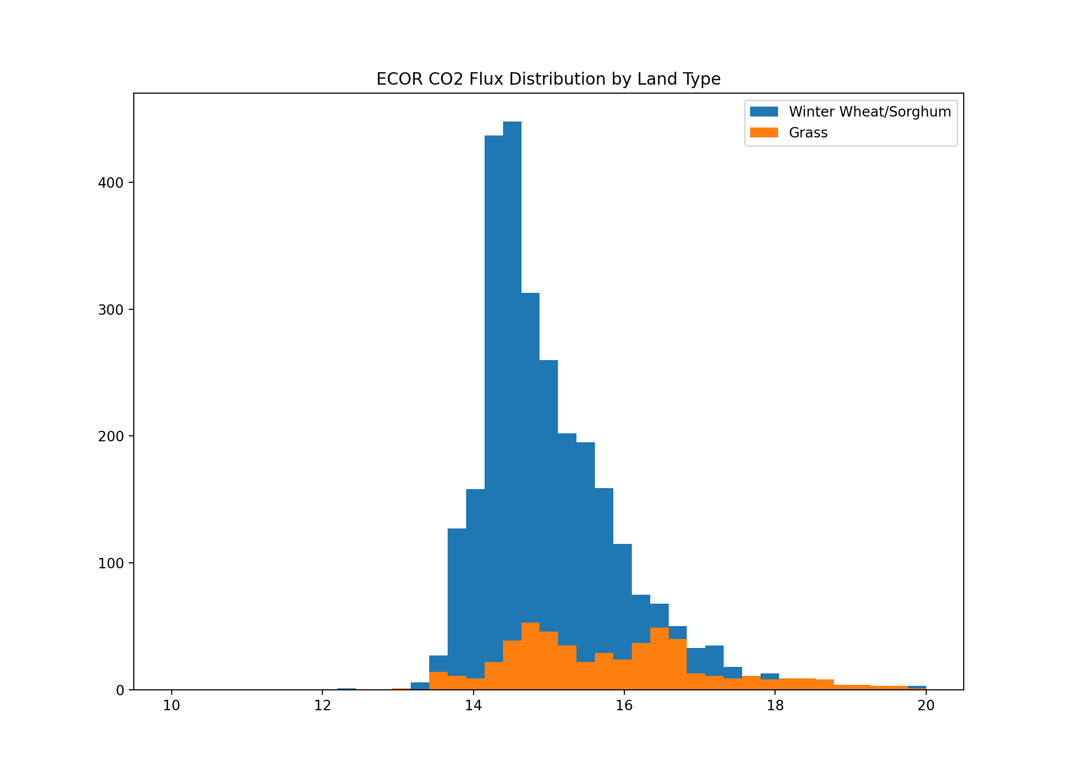
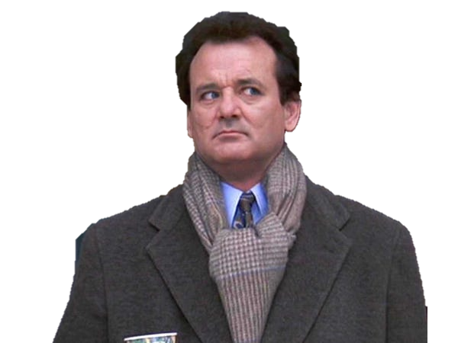

So really, what does it do?
Discovery
ARM Live Data Web Service (www.arm.gov)
Petabytes of data back to 1993 all free!
Automated Surface Observing Systems (ASOS) API from Iowa Environmental Mesonet
USDA CropScape
https://github.com/ARM-DOE/ACT
Notes:
So, that’s all a great dream, but what does this do? Well, let’s dive in. For our discovery module for puling data from APIs and putting it into a dataset, we are still exploring other libraries and avenues because we don’t want to recreate the wheel but what we do have are scripts to pull data from
ARM
ASOS from Iowa Environmental Mesonet
And crop type from USDA scropscape portal.
Now I know what you’re thinking, what’s that doing in here. Well, with some of the instruments that our program and other programs deploy, the crop or land surface type is very informative when doing analysis, specifically looking at CO2 and water vapor flux as shown in the plot on the right. Your measurements at the surface are going to be impacted by the crop or land surface type and cropscape has a great portal and history of data that can then be coupled with this.

Slide 8
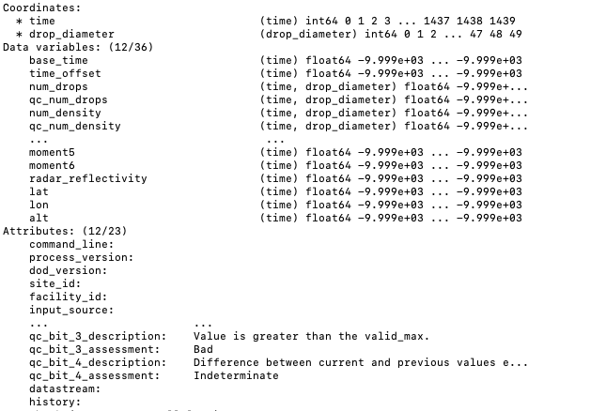
Don’t get hung up on API for crop type!
I/O
xarray for netcdf
Pandas read_csv for text/csv files, converting to Dataset
Specific readers for NOAA Global Monitoring Laboratory (GML) data
Surface Met, Radiation, Ozone, CO2, HALO
Binary micropulse lidar using MPL2NC from Peter Kuma
Convert data to a temporary netcdf file and read in
Clone data file structures from ARM program to create “empty” xarray Datasets
Write files out to better match Climate and Forecast Standards
https://github.com/ARM-DOE/ACT

Slide 9
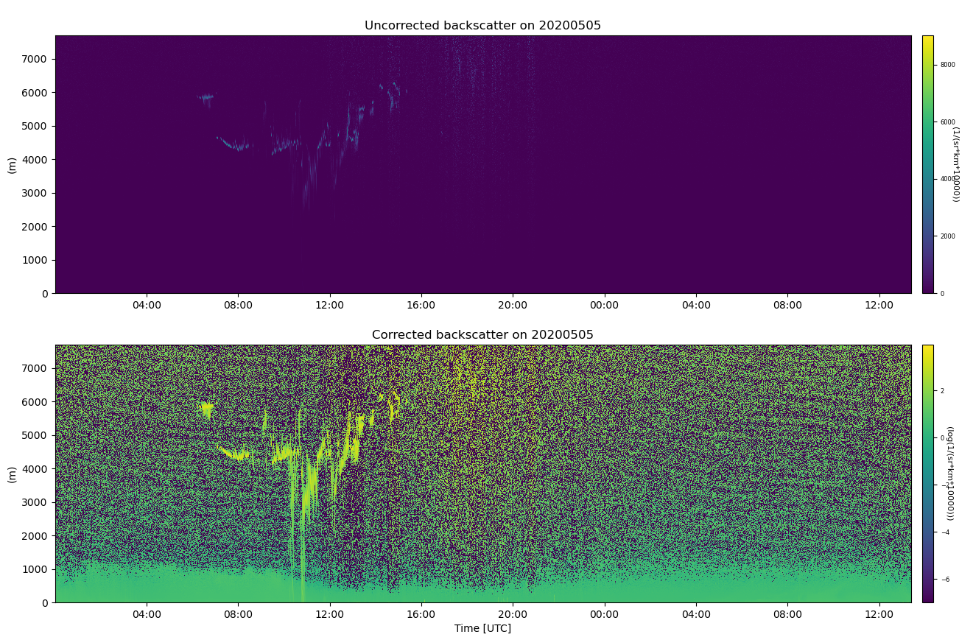
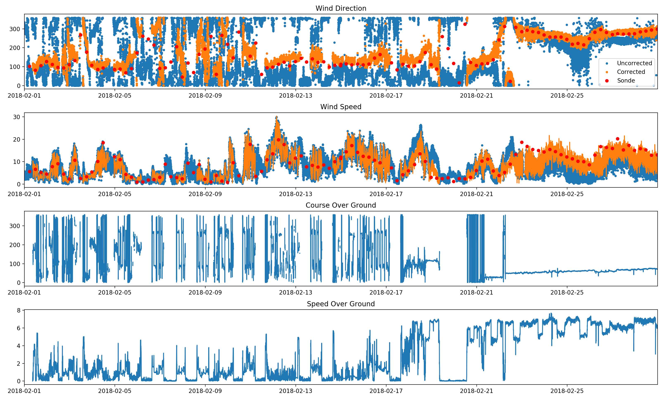
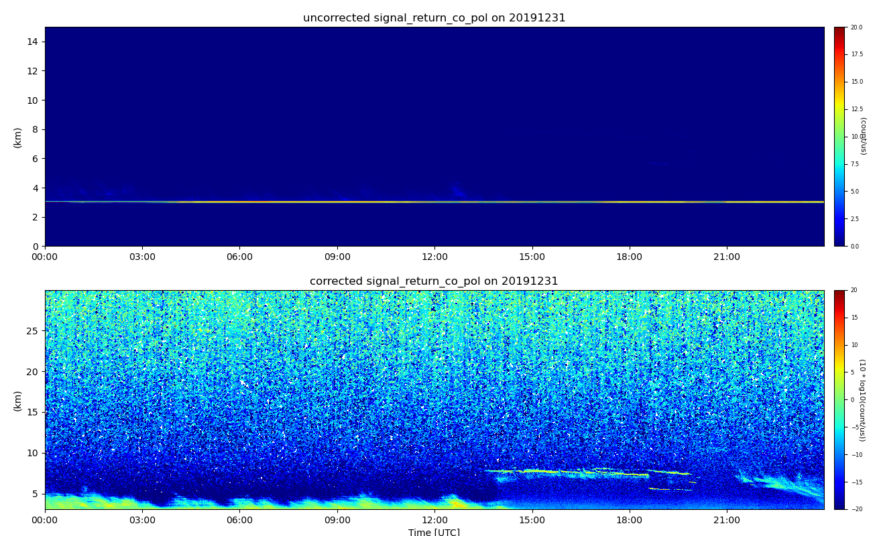
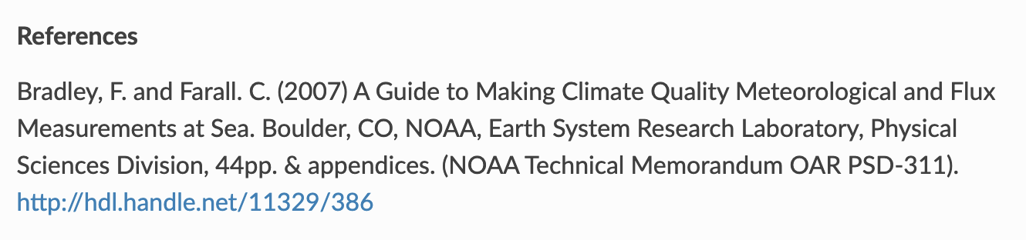
Is that it?
Corrections
Correct lidar data like micropulse lidar for deadtime, afterpulse, overlap, etc…
Correcting ceilometer data for easier visual analysis
Wind-corrections for ship motion
https://github.com/ARM-DOE/ACT

Slide 10
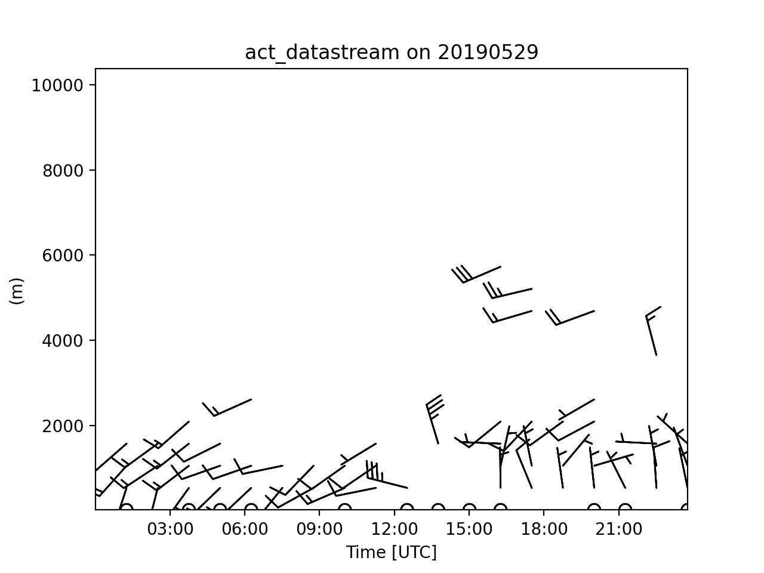
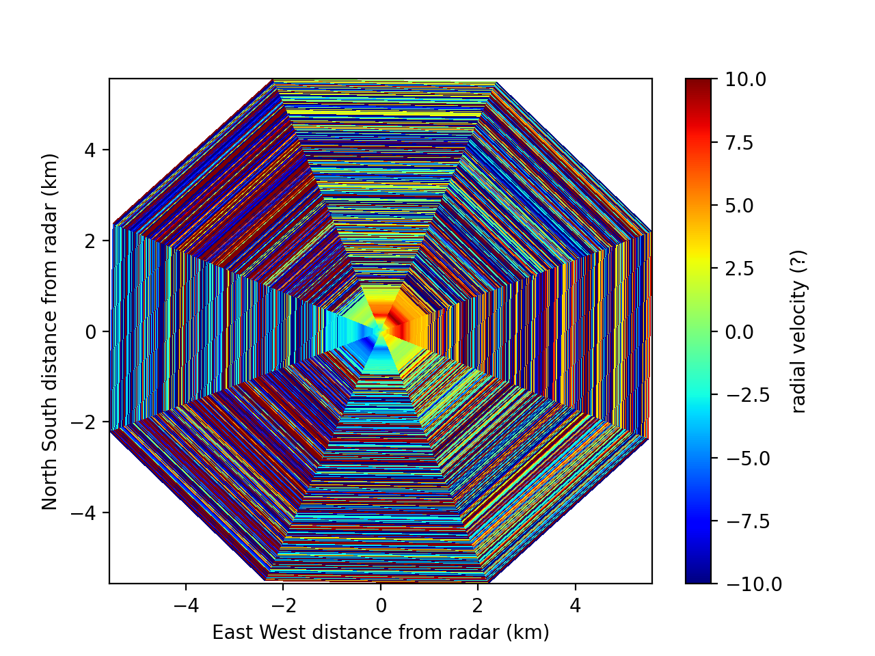
What else?
https://github.com/ARM-DOE/pyart
Retrievals
Wind Profiles from Scanning Doppler Lidar (Newsom et al. 2016)
Sky infrared temperature from AERI irradiances
Solar radiation calculations
Net radiation, longwave radiance for cloudy/clear conditions
Sea surface temperature from infrared radiometer measurements
Want to grow more!
References
Rob K Newsom, Alan W Brewer, James M Wilczak, Daniel E Wolfe, Steven P Oncley and Julie K Lundquist ; Validating Precision Estimates in Horizontal Wind Measurements from a Doppler Lidar, Atmospheric Measurement Techniques Discussions 2016, 10, 1-30

Slide 11
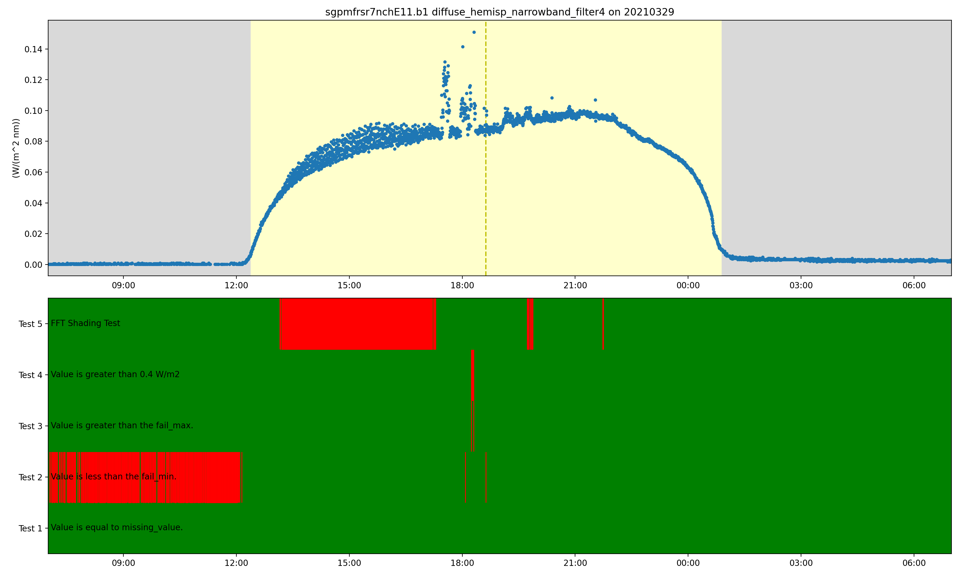
But wait! There’s more!
Quality Control
Apply additional tests
Simple limit tests to more advanced like the FFT method to detect shading problems with shadowband radiometers
Using bit-packed QC to allow for multiple tests to be set at once
Plotting tools to visualize this information
FFT Shading Test
Simple Limit Test
https://github.com/ARM-DOE/ACT
https://www.arm.gov/news/blog/post/69939

Slide 12
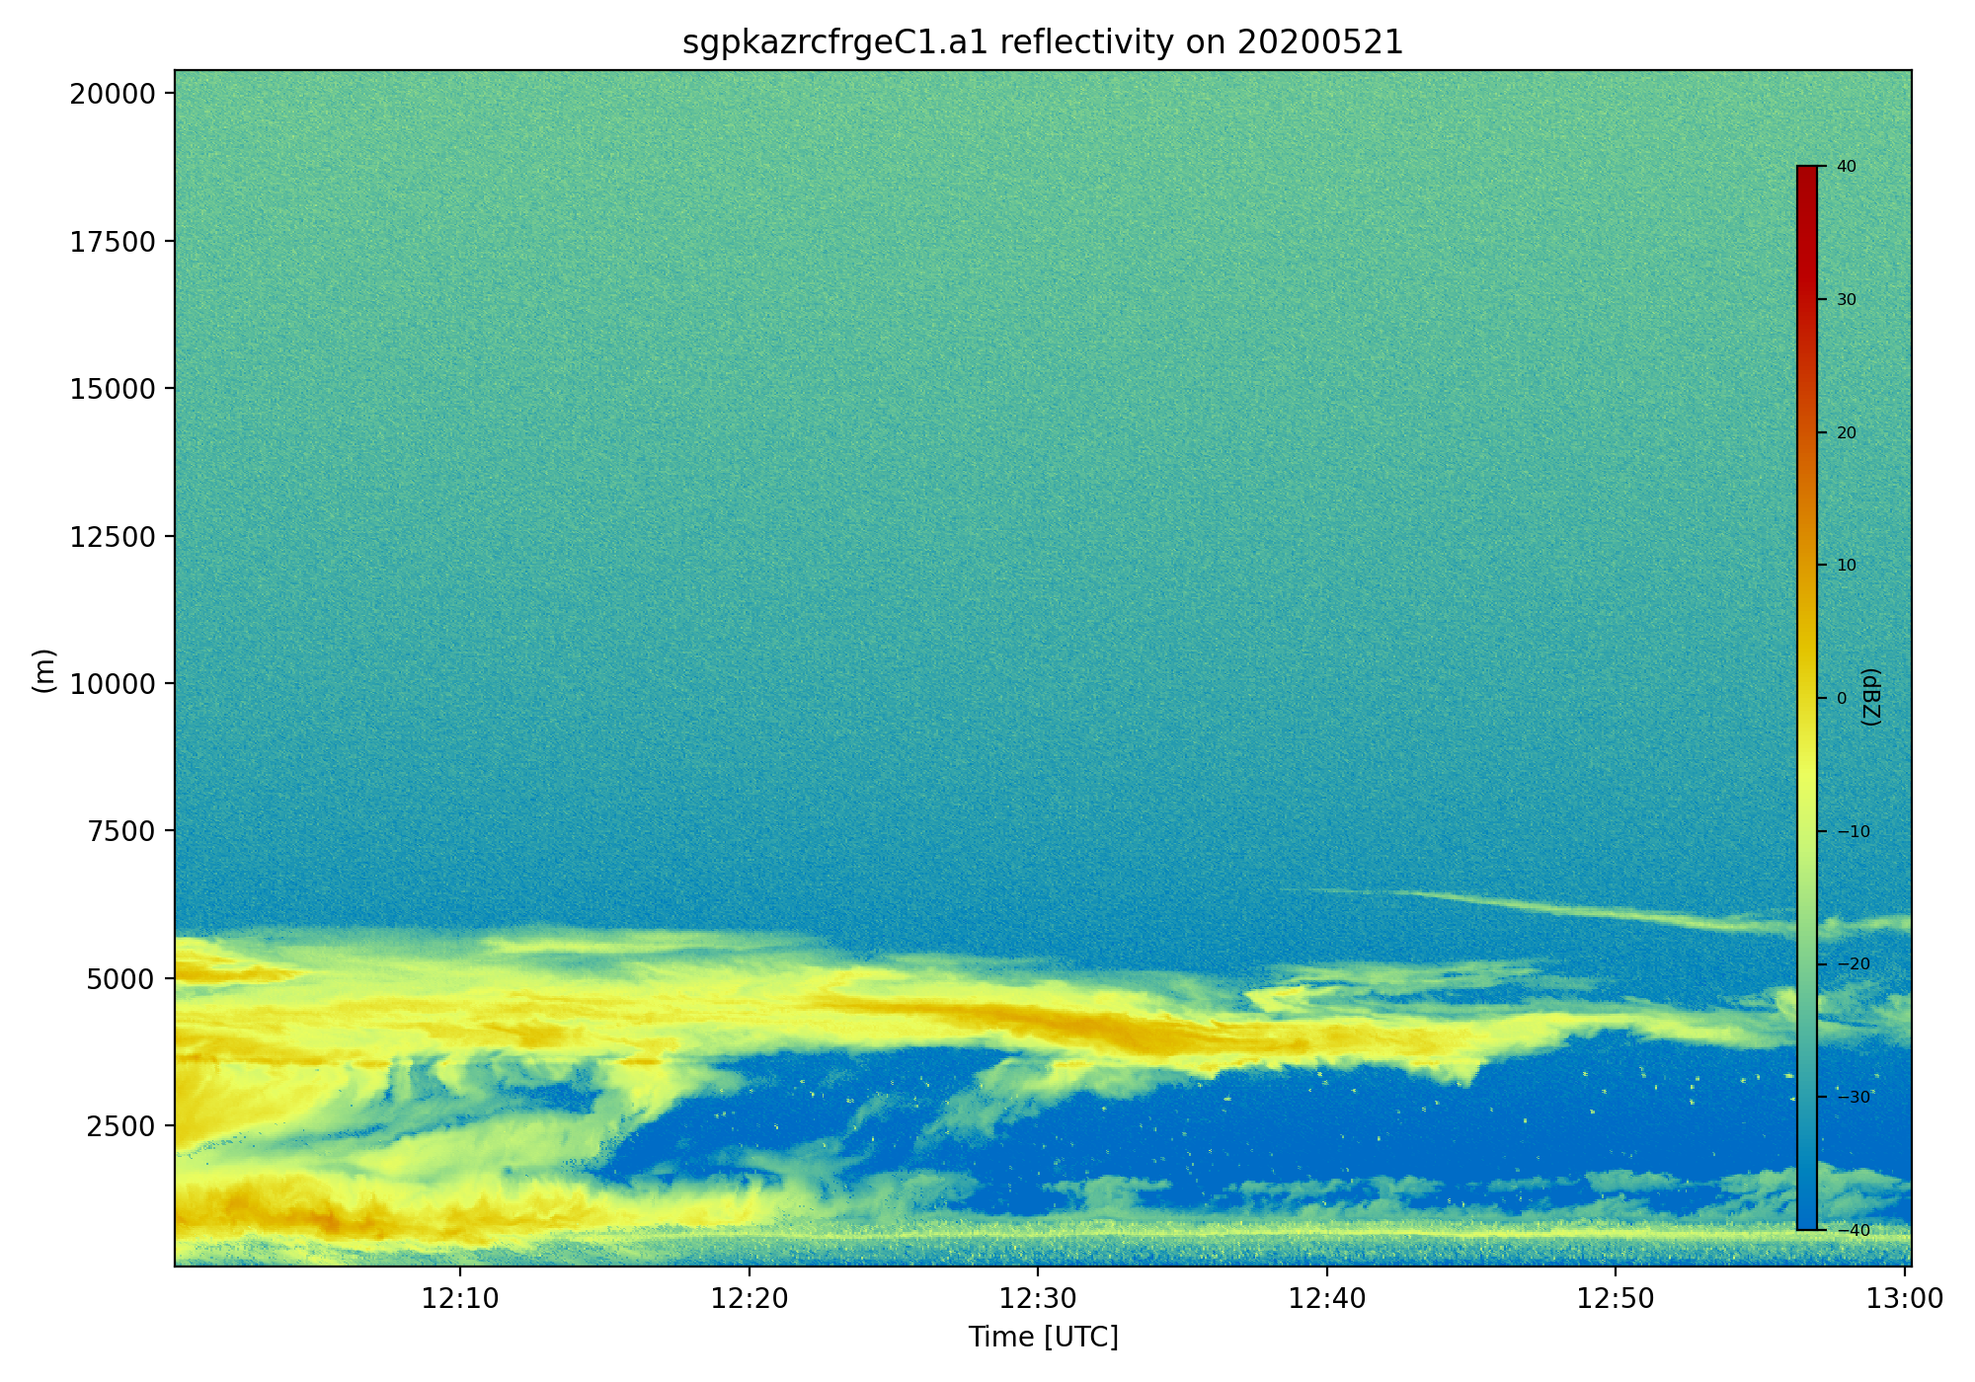
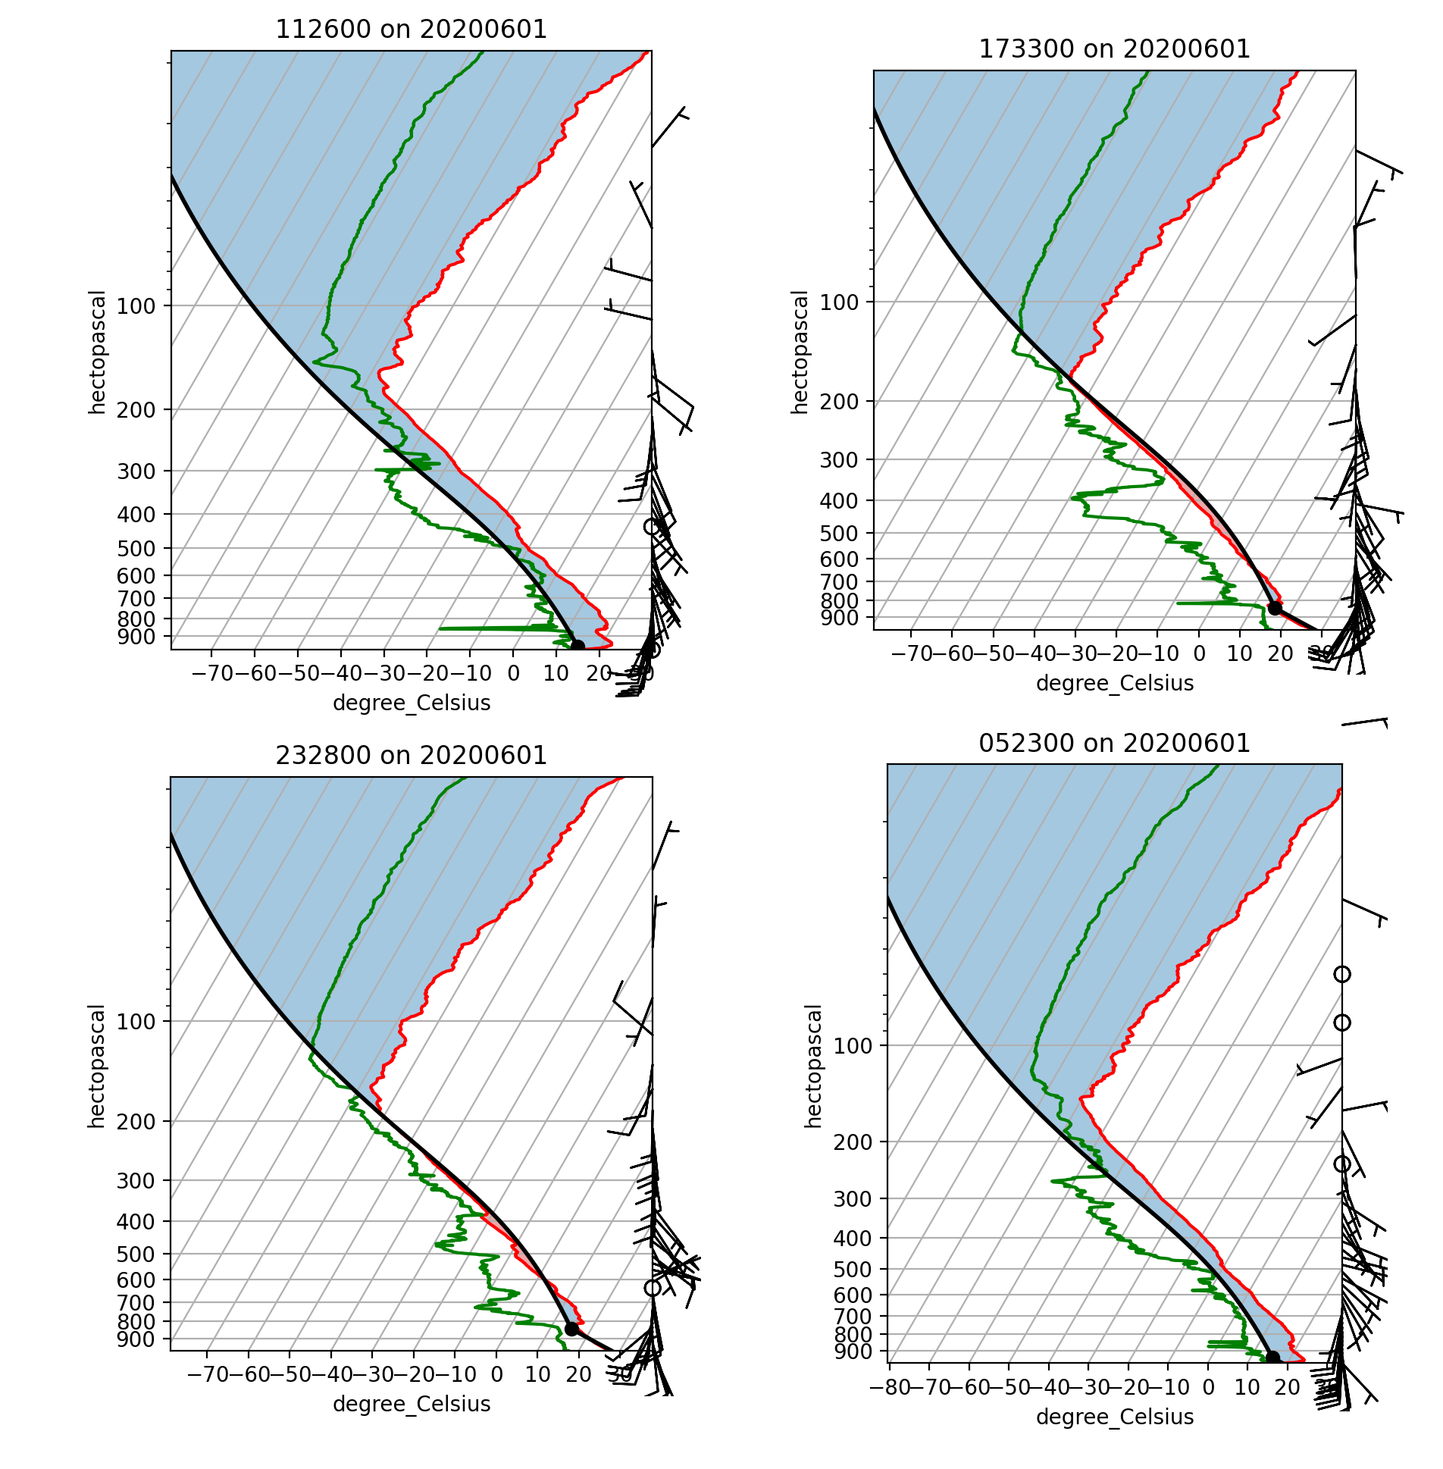
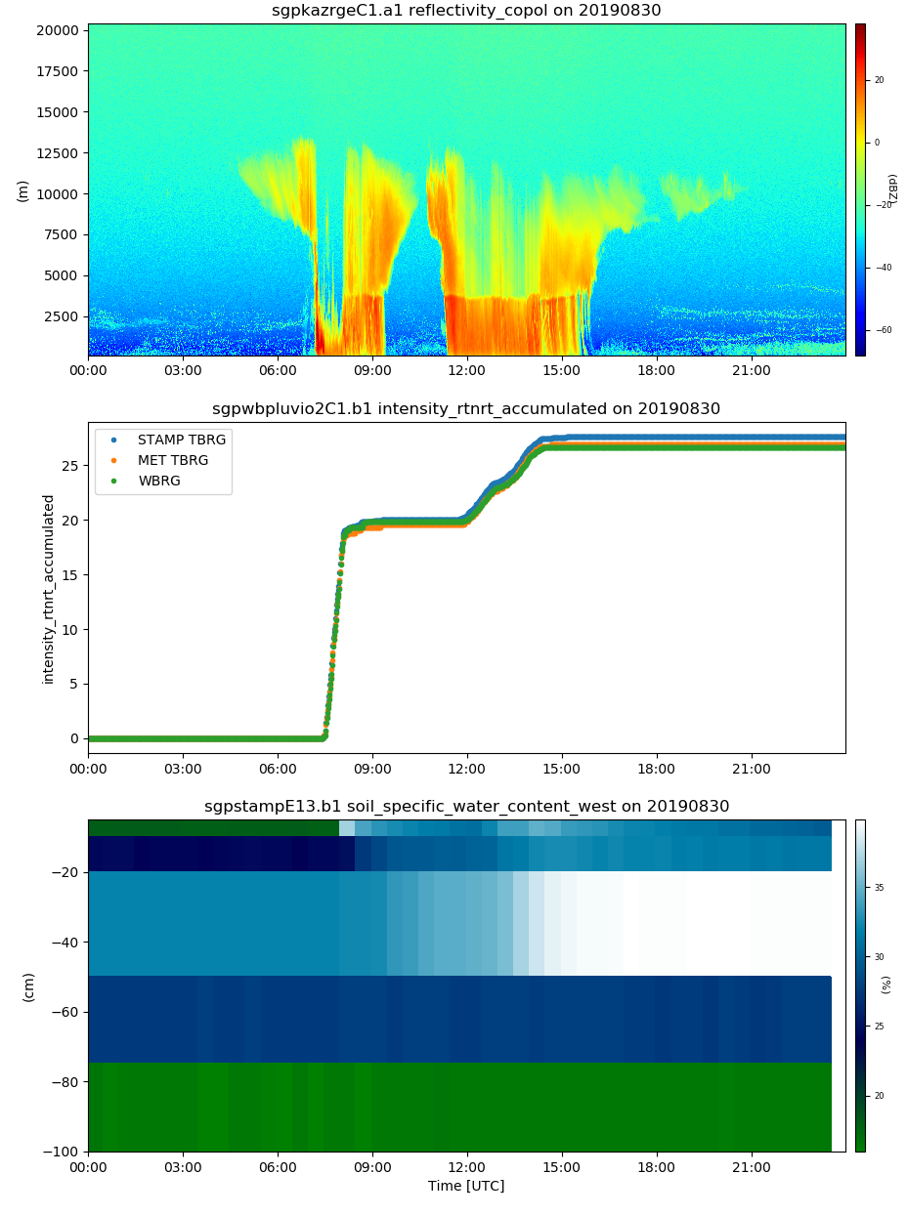
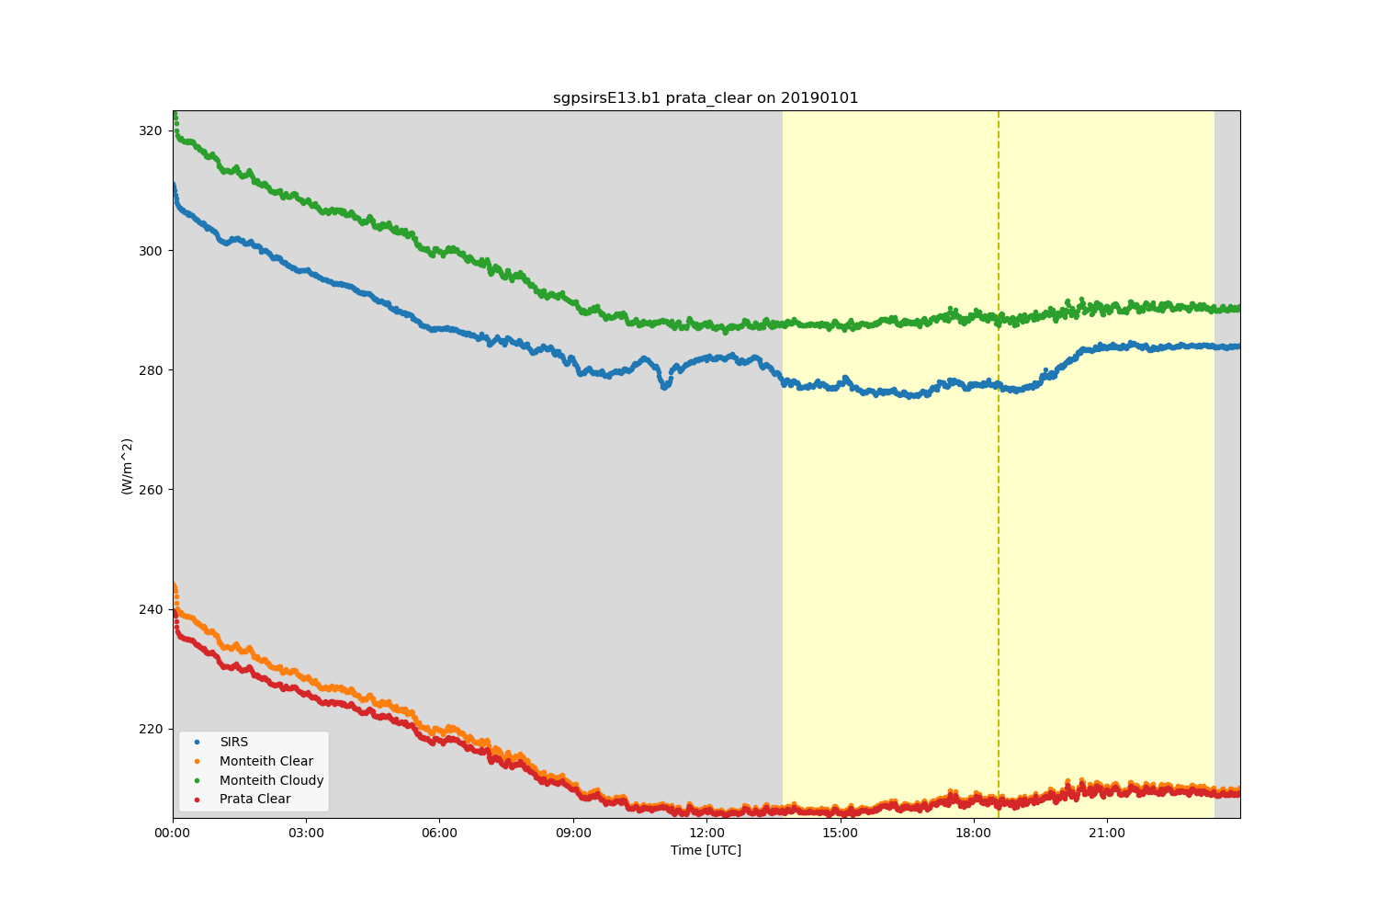
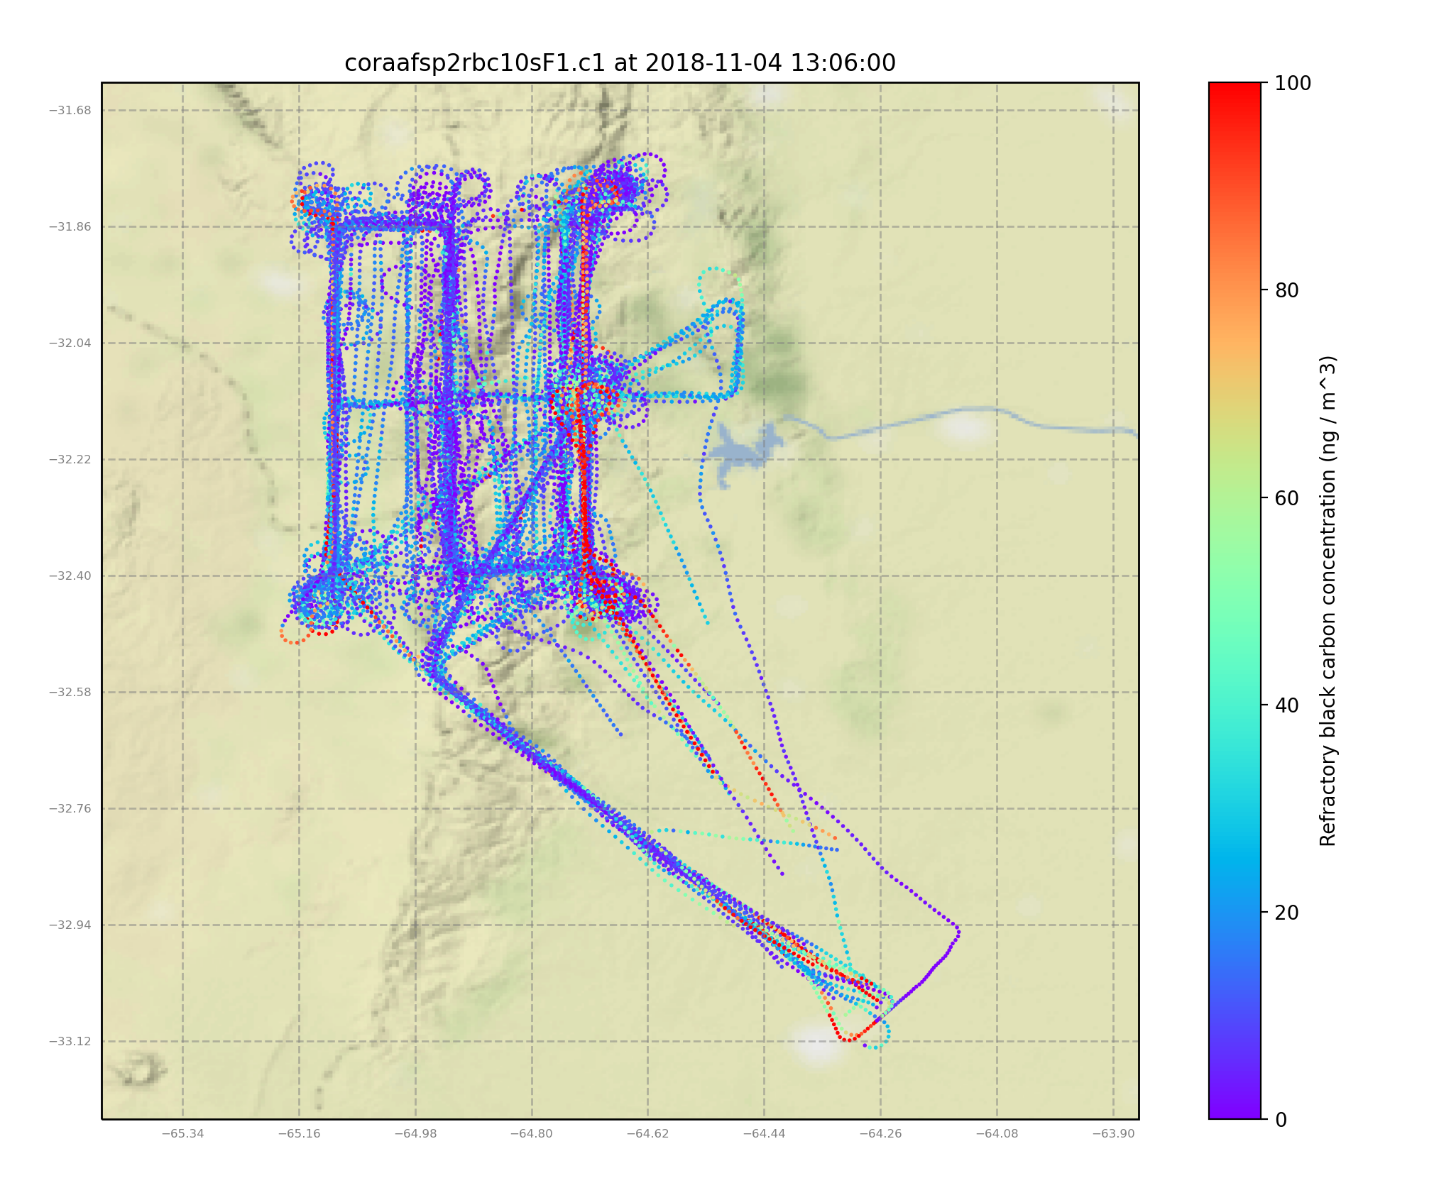
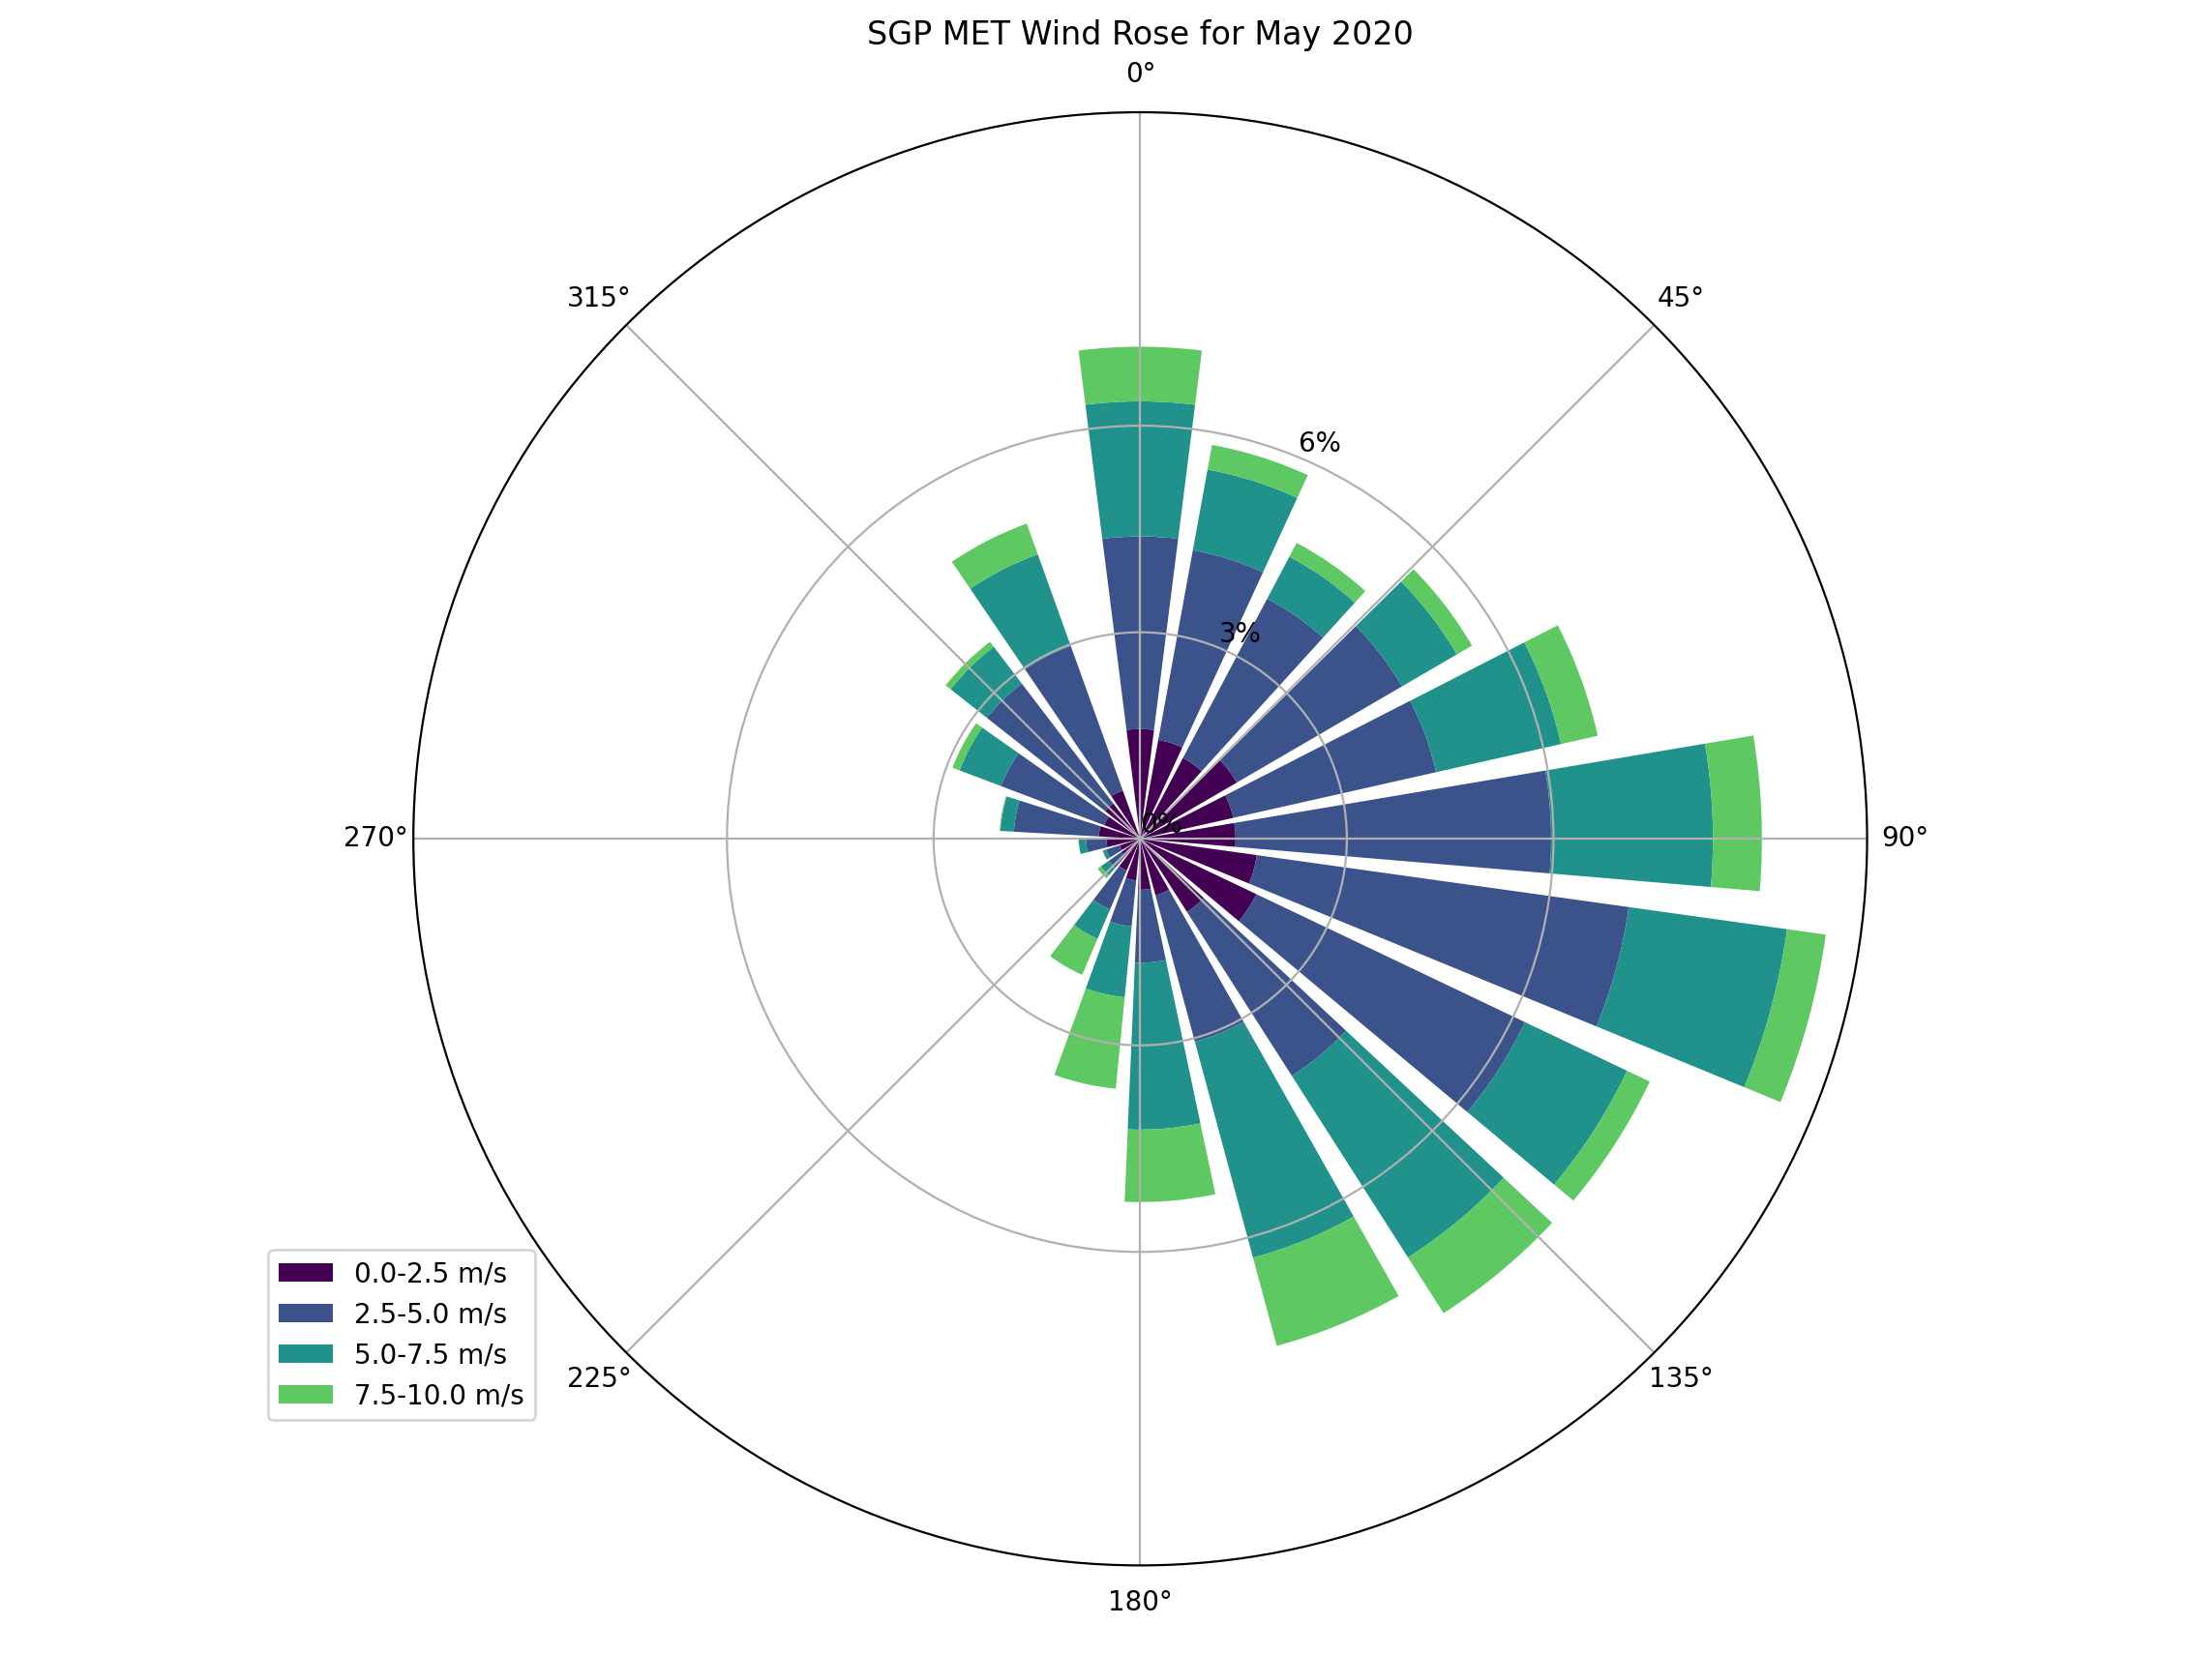
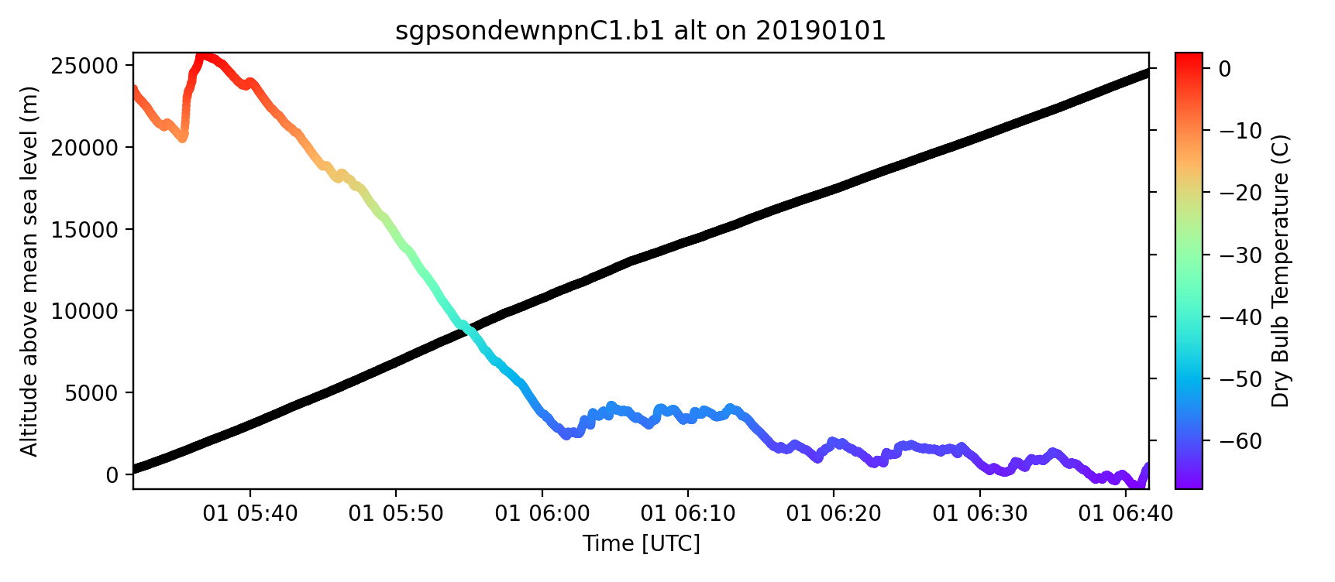
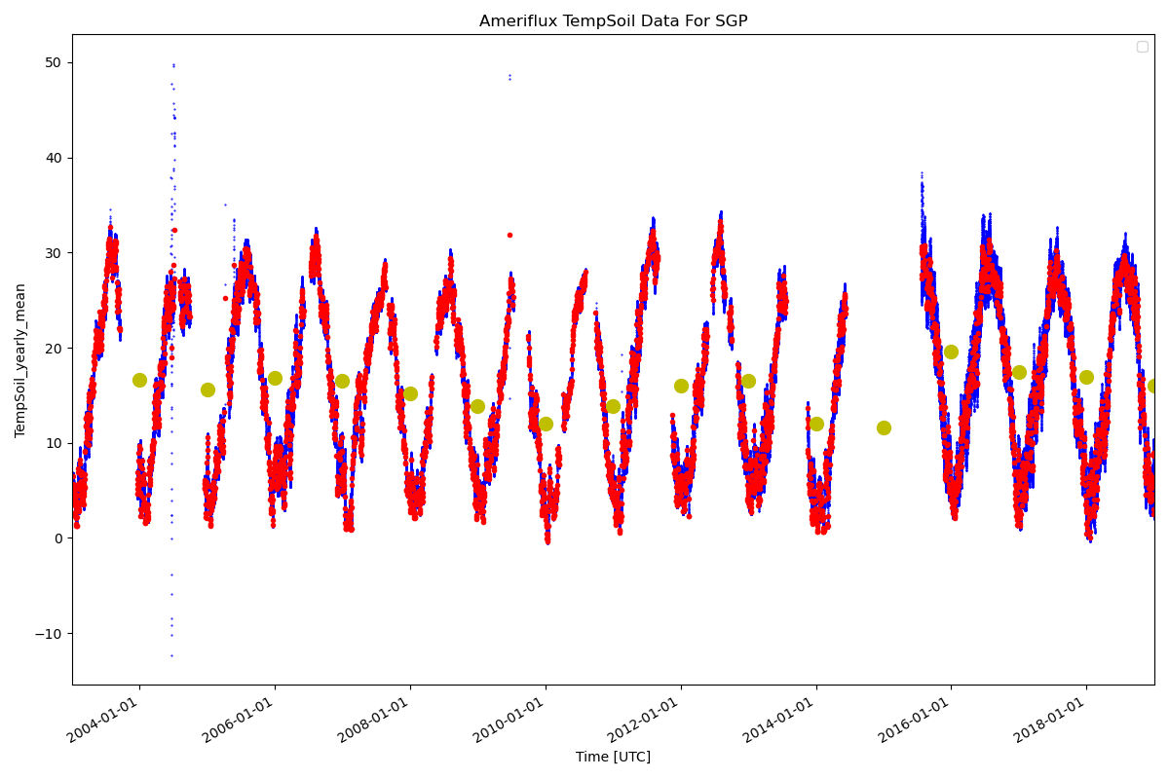
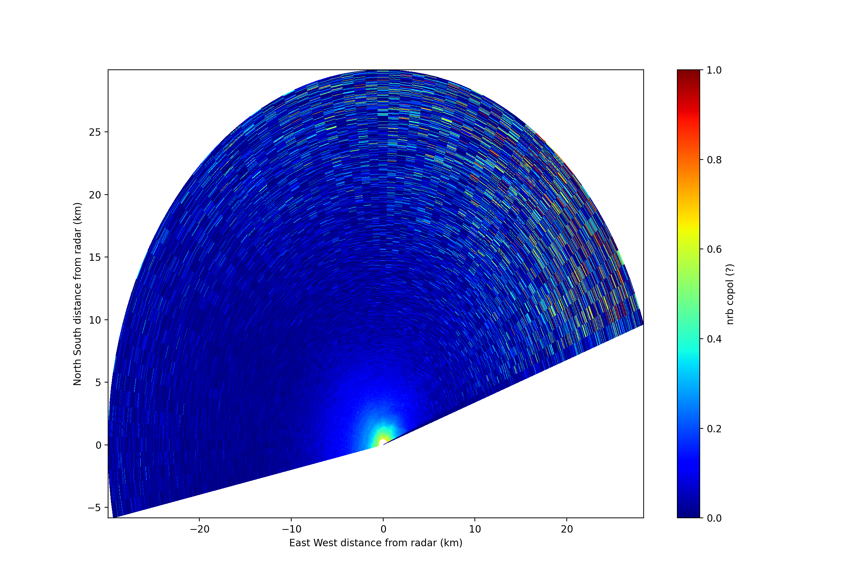
And more!
METPy

Slide 13
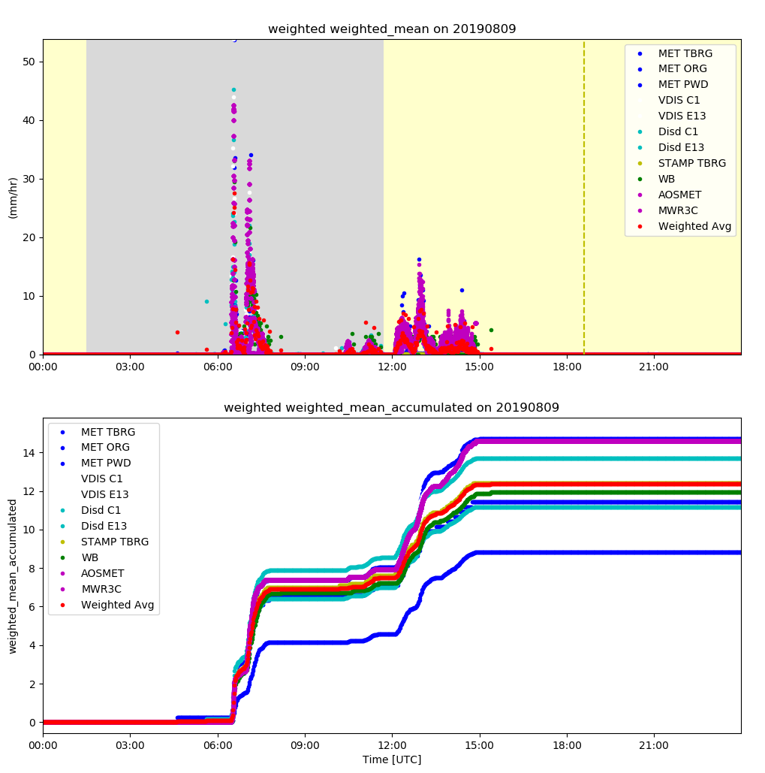
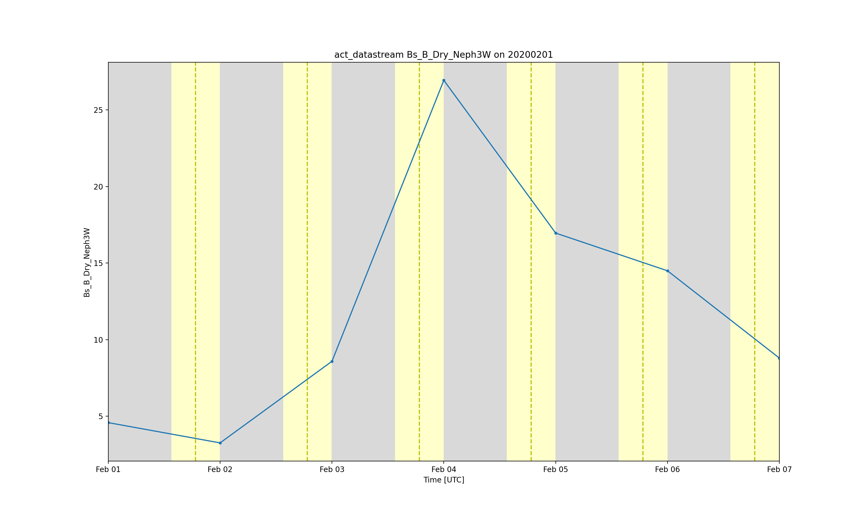
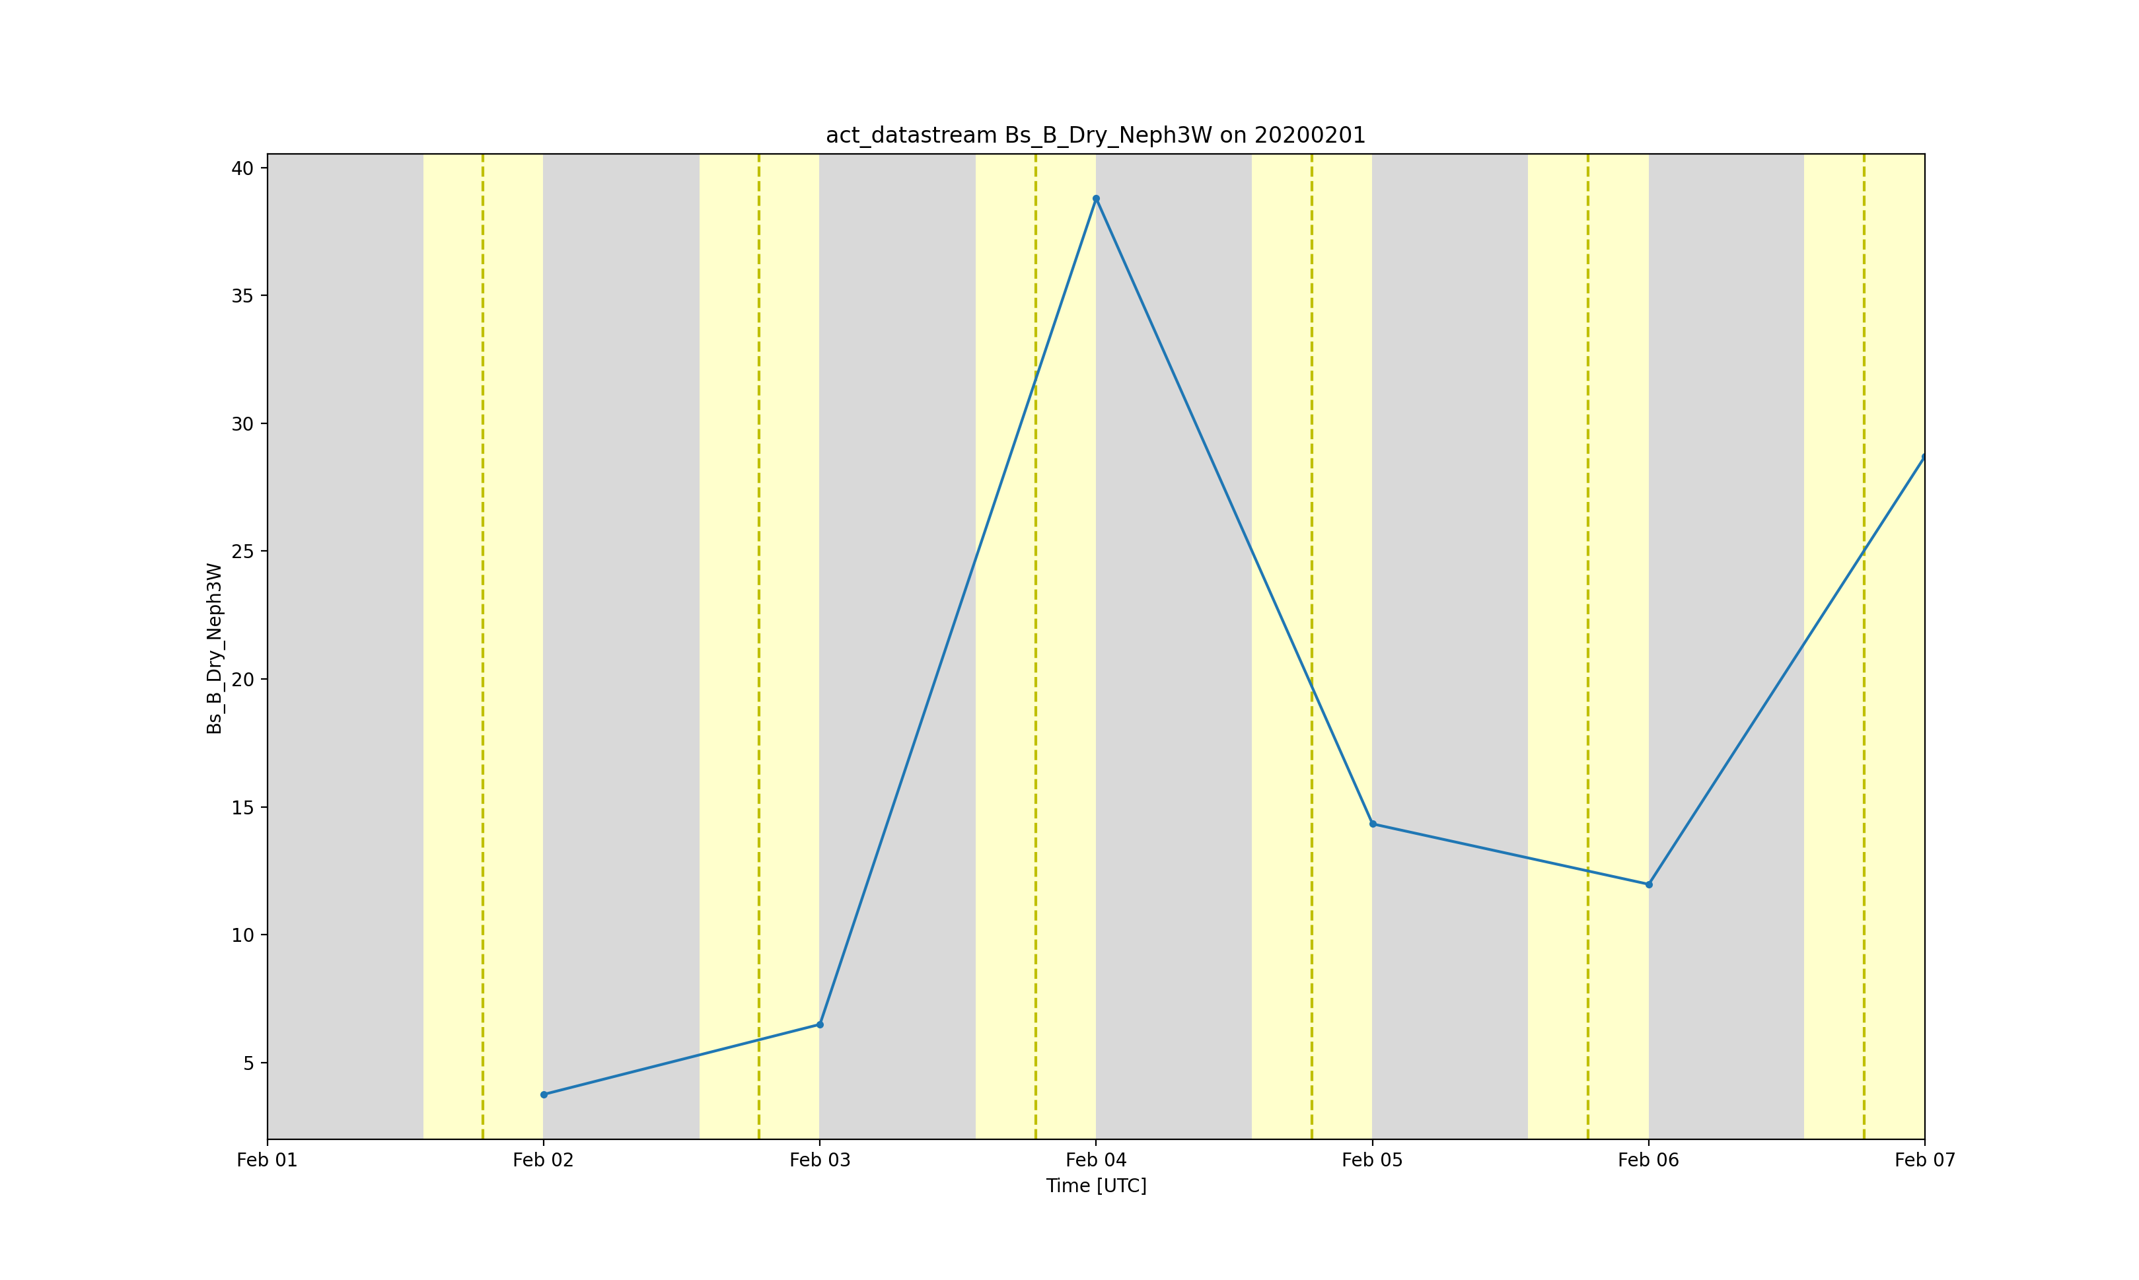
And Finally
General Utilities
Precipitation accumulation
Weighted averaging
Solar calculations using Skyfield
Sunrise, sunset, dawn, dusk
Decode present weather detector based on WMO Table
Planck converter
Radiance to temperature and vice versa
Note, not everyone’s constants are the same!
Daytime averages
Nighttime averages

Slide 14
Forecasting the road ahead
Actively engaging at conferences
NOAA GML Annual Conference
Ameriflux Land Atmosphere Interactions Workshop
ARM/ASR PI Meeting
SciPy
More to come!
Surveying the community to set priorities for future development
Boundary layer height calculations
Interactive plotting
3D visualizations
Please visit the Github page, report issues, start discussions, and get involved!
Here and happy to help!
https://github.com/ARM-DOE/ACT
https://www.surveymonkey.com/r/actsurvey2021

